Slide 1
Whole-Part-Whole Learning Process

Slide 2
What is WPW?

Slide 3
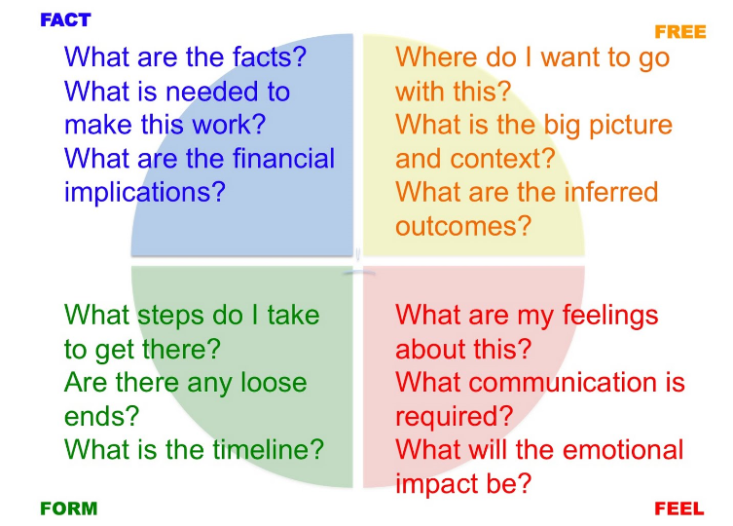

Slide 4
WHOLE-PART-WHOLE LEARNING PROCESS
It represents a practical methodology for designing learning programs. It is useful for the overall design of learning programs of any length- total courses, as well as, for short learning experiences. The Whole-Part-Whole (WPW) learning model offers a helpful framework for developing training and instruction for adults.

Slide 5
Basic Whole-Part-Whole Learning Model
As you can see in the chart, learners are exposed to the first “whole,” in which they are prepared for new instruction by being presented a “mental Scaffolding” – the learning objectives and building-block concepts placed within the larger framework of the topic. Also serves to motivate learners and provide context for learning.

Slide 6
Then instruction focuses on the “parts”— what has been defined as the details of knowledge, expertise, and activity. After learners have mastered the specific, structured material, it is time to return to the “whole.”

Slide 7
The second “whole” helps learners place their newly-mastered skills in context. In many cases the whole cannot truly be understood (or, in the case of skills, performed) without an understanding and proficiency of the individual parts, so the return to the whole allows the learner a second chance to arrive at a more nuanced understanding of the whole concept.

Slide 8
Knowles, Holton, and Swanson note:
This learning template can be used at both the program design and lesson design levels. From a systems perspective, each of the program segments, whether they are classified as a part or a whole, can then constitute a subsystem.

Slide 9
Example:
For example, a coach might teach the triple jump by first demonstrating the “whole” action (hop, step, and jump in sequence) and then have the athlete practice each of the components or “parts” of the event. Finally, the coach would again demonstrate the complete triple jump and have the athlete combine the three components and practice the entire sequence.

Slide 10
The WPW learning model is a particularly useful template for presenting difficult and complex educational content. The model is effective because it encourages training or instruction that gives learners an overview of what they are about to learn, drills down to the specifics, and then integrates the new knowledge or skills into a broader framework.

Slide 11
Online WPW learning
Online learning is well suited for using the WPW learning model’s structure. Hyperlinked navigation can map out the relationship between the parts and the whole. Developing modular learning objects further aids in guiding the learner through a connected whole-part-whole learning program.

Slide 12
For example, an online course on budgeting might start with an overview of the master budget and show how it is decomposed into the operating and financial budgets before teaching how each of the sub-budgets is sequentially prepared. The course might conclude with the learner creating a master budget through creating its constituent parts (sales budget, production budget, direct materials budget, etc.).

Slide 13
This WPW-inspired format develops the learner’s cognitive skills on all levels (knowledge, comprehension, application, analysis, synthesis, and evaluation), leveraging the learner’s newly-acquired skills to reinforce the understanding of the overall concept.

Slide 14
Good course designers can rein in hypertext’s potential for inducing fragmented learning by keeping the WPW learning model in mind during planning and development, ensuring that course navigation and presentation of content reinforce the relationship between the parts and the whole.

Slide 15
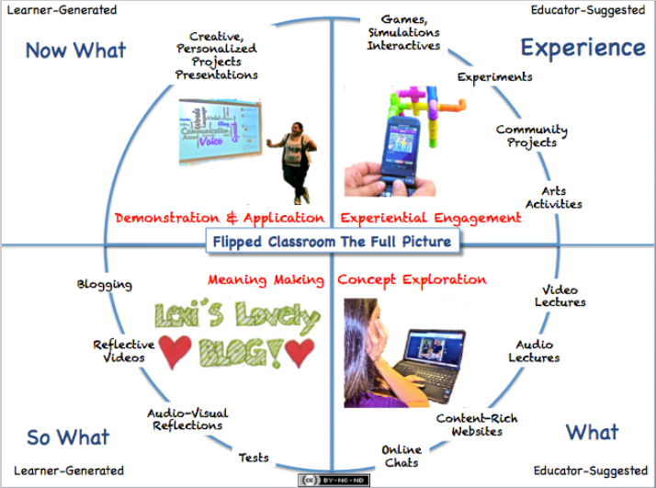

Slide 16
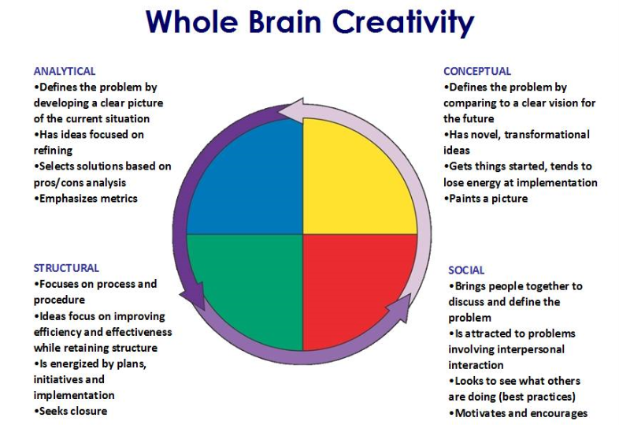

Slide 17
Teaching Methods
The aim of this lesson is to learn about the different methods used in teaching and varying ways of practicing a new skill.
During lessons and training sessions, the teacher must provide guidance to the students to ensure they learn effectively. To do this the demonstration and practice of the new skill will be manipulated by the teacher to best suit the individual, skill and situation.

Slide 18
There are four parts to teaching a new skill:
Instructing - instructions must be given for them to complete the task or skill. These may be written or verbal. The teacher must ensure the student knows what is required of them
Demonstrating - The teacher may provide a demonstration of the skill or may get a peer to perform it. It is key that this is a good demonstration to allow the student to form a model in their memory and mentally rehearse the skill to be performed

Slide 19
Applying - The student then practices the skill in a planned situation to help them transfer the learning from practice to a competitive situation
Confirming - This is all about feedback and providing information for the student about how successful they have been. Testing or assessing the skill allows the teacher and the student to evaluate performance.

Slide 20
Methods of Practice
Certain skills are best taught in different ways depending on the learner and the skill in question:
Whole method
The skill is first demonstrated and then practiced as a whole, from start to finish. It helps the learner to get a feel for the skill, timings and end product. It is best used for fast skills which cannot easily be separated into sub-parts, such as a javelin throw. It is unsuitable for people with low attention spans, complex or dangerous skills.

Slide 21
Part method
The parts of the skill are practiced in isolation which is useful for complicated and serial skills and is good for maintaining motivation and focusing on specific elements of the skill. It is possible, however, that the transfer of the skills from parts, to a whole may not be effective and it may also reduce the kinaesthetic awareness (feel) for the full skill.

Slide 22
Whole-part-whole method
The whole skill is first demonstrated and practised, before being broken down into the constituent parts to practice the individual elements and improve on these, before putting the whole skill back together. This can be very effective in skills which have easily distinguished parts, where the whole skill together is complex.

Slide 23
A good example comes in swimming, where the learner would practice the whole stroke, then isolate a weak component, such as the kick and use a float in the hands to ensure using only the legs, before putting the whole stroke back together. This gives the performer a sense of the whole skill before they break it down and improve on the weak aspects of the performance. As with the part method this may affect the transfer of the skill from parts to the whole.

Slide 24
Progressive part method
This is sometimes also known as the chaining method, as the parts of a skill are practiced individually, in order, before being linked together and expanded. For example in sports class: in the triple jump, the hop will be practiced and learnt, before the skip is then practiced and learnt. The two are then linked together. Finally the jump will be learnt individually and then tagged on the end of the skip. This is slow process but allows weaknesses to be targeted and for the performer to understand the relationship of the sub-routines.

Slide 25
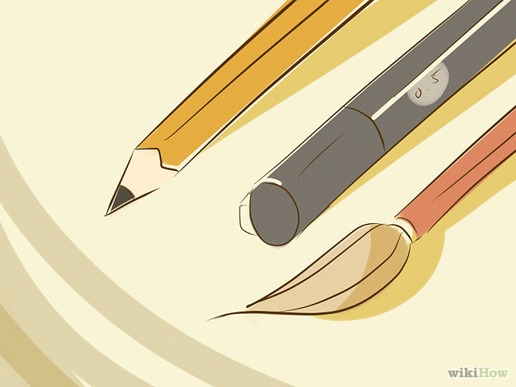
Check DROPBOX NEXT WEEK
Groups have been formed
For presentations.

