Slide 1
Core Competency Diagnostic and Planning Guide
Erick González
Abigail Escobar
Katherine Escobar
Paola Guerra
Keisy Fajardo

Slide 2
What is a core?

Slide 3
What is a core competency?

Slide 4
Core Competency
A person must demonstrate abilities and skills rather than completion of training courses, or only passing a test.

Slide 5
“A measurable human capacity that is required for effective performance.
Success?
Pursue?
Must surround
Passion
Knowledge
Experience (help, succeed)

Slide 6
Flexible Learning
It is about providing learners with choices regarding when, where and how learning occurs.
(The pace, place and mode of delivery).
It helps to attract and meet the needs of an increasingly. diverse range of students and includes making appropriate use of technology to support the learning process.

Slide 7
What’s the difference between Pedagogy and Andragogy?
What do we have to do with our students?
Change their lives.

Slide 8
Learning Facilitator

Slide 9
Adult learning facilitator are expected to be competent in several key areas to be considered effective facilitators.
They are expected to demonstrate competency in five core areas.
Knowledge of Subject Areas
Creative Thinking
Leadership
Classroom Management
Commitment

Slide 10
“A facilitator is a bridge between the learner and the learning” Ashok P. Das

Slide 11
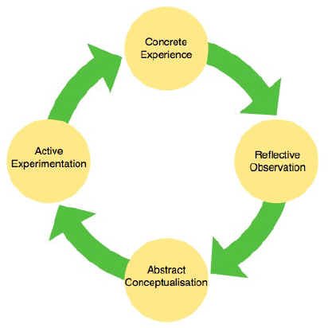
Learning Facilitator

Slide 12
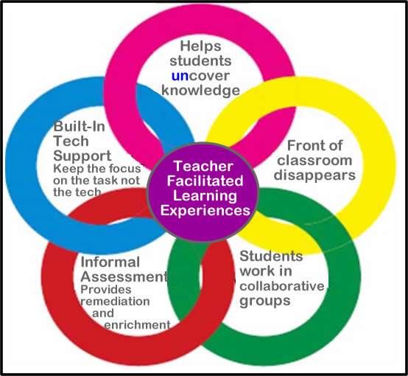

Slide 13
Conceptual and theoretical framework of Adult Learning

Slide 14
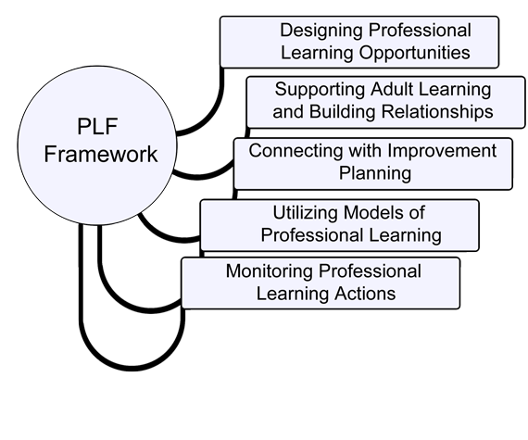

Slide 15
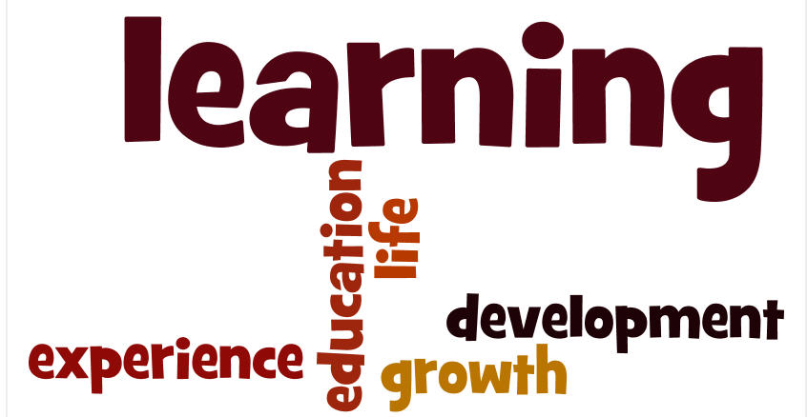

Slide 17
Learning Experience
Learning experience refers to any interaction, course, program, or other experience in which learning takes place, whether it occurs in traditional academic settings (schools, classrooms) or nontraditional settings (outside-of-school locations, outdoor environments), or whether it includes traditional educational interactions (students learning from teachers and professors) or nontraditional interactions (students learning through games and interactive software applications).

Slide 18
Learning experience may also be used to underscore or reinforce the goal of an educational interaction—learning—rather than its location (school) or format (course). The growing use of the term learning experience by educators and others reflects larger pedagogical and technological shifts that have occurred in the design and delivery of education to students, and it most likely represents an attempt to update conceptions of how, when, and where learning does and can take place.
Example:

Slide 19
Competencies

Slide 20
1. Ability to describe the difference between a content plan and a process design.
2. Ability to design learning experiences for accomplishing a variety of purposes tat take into account individual differences among learners.

Slide 21
4. Ability to establish a warm, empathic, facilitative relationship with learners of all sorts.
3. Ability to engineer a physical and psychological climate of mutual respect, trust, openness, supportiveness, and safety.

Slide 22
5. Ability to engage learners responsibility in self-diagnosis of needs for learning.
6. Ability to engage learners in formulation objectives that are meaningful to them.

Slide 23
7. Ability to involve learners in the planning, conducting, and evaluating of learning activities appropriately.

Slide 24
Self-Directing

Slide 26
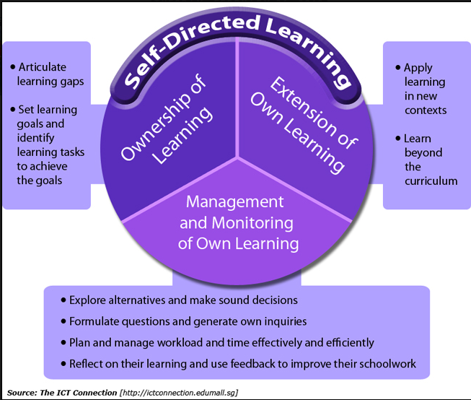

Slide 27
Selecting Methods, Techniques, and Materials

Slide 28
Planning Guide

Slide 29
Planning guide is likely to be important in our objectives, sometimes it involves positive and negative indicators.

Slide 30
Positive Indicators | Negative Indicators
Develops clear goals that are consistent with ageed strategies. | Organizes impractical work schedules
Identifies priority activities and assignments. | No checks on activities, tasks not completed,

Slide 31
Characteristics: Planning guide is like a map about our life and decisions. When following planning guide , you can always see how much you have progressed towards your project goal and how far you are from your destination. Knowing where you are essential for making good decisions on where to go or what to do next.

Slide 32
Action plan techniques Learn to plan efficiently. Simple and powerful techniques to convert your goals and ideas into an effective action plan. Organize Ideas, tips, tools and more to help you organize your life. Time management skills and techniques: The important time skills, techniques, and activities. Personal time Practical information and various goals around our life.

Slide 33
Assess-ment
Guidance
Building communi-ty
Commu-nication
Humani-zing
Evaluating
Six Components

Slide 34
Planning Process

Slide 35
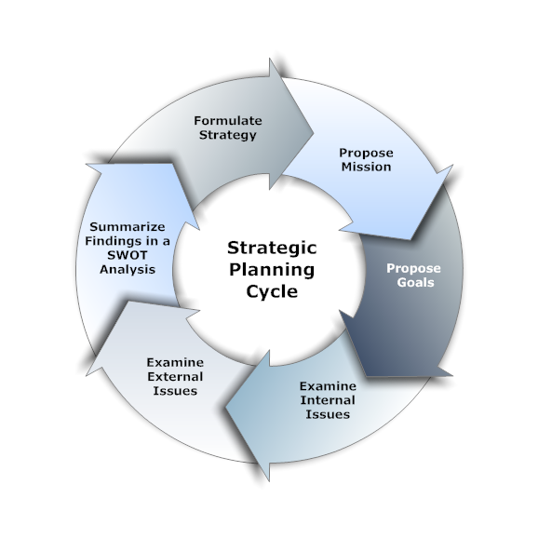

Slide 36
Understanding Organizational Development and Maintenance

Slide 37
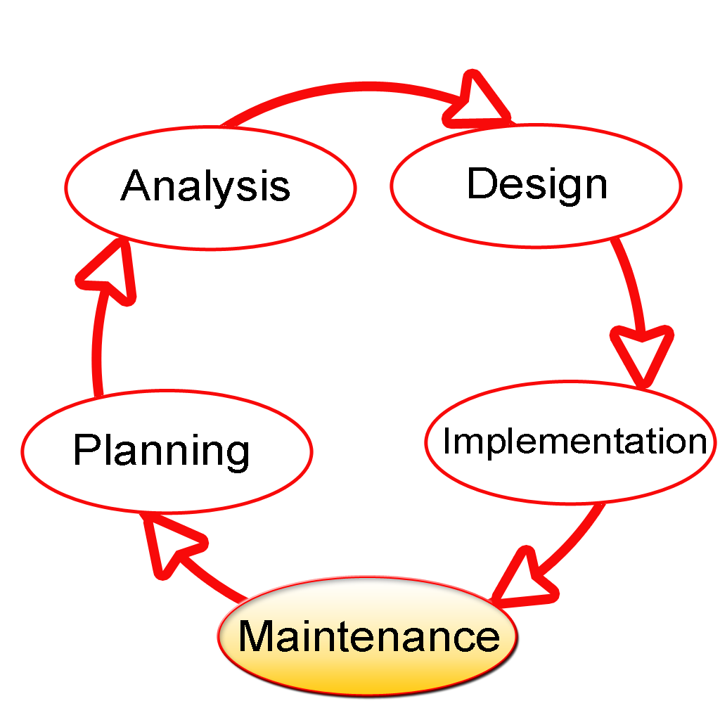

Slide 38
