Slide 1
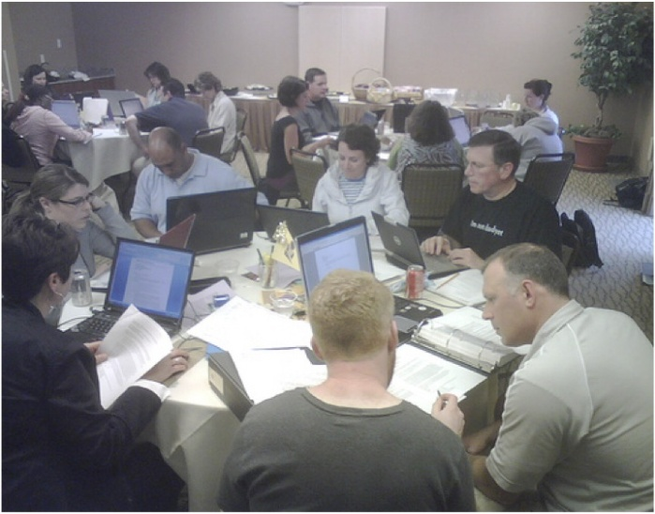
A Theory of Effective Computer-Based Instruction for Adults.
Group No. 4
Rudy Soto
Josué David Rivas
Emanuel Santizo
Priscila Rodríguez

Slide 2
Introduction.
It reinforces and provides an extra practice of activities learnt in a previous attendance student class
Servers
Platforms
Special websites

Slide 3
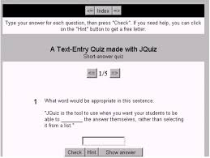
Teachers are able to:
Use this resource to advance in different
types of tasks of assignments of a class.
Platforms allow teachers to submit students to have quizzes and full evaluations of all units already customized.
Teachers are able to monitor and scored students’ advances through the automatic checking system of the platform.

Slide 4
Advantages for students:
Caters listening comprehension as if
students were having a dialog with a
native English speaker
2. Caters reading comprehension
3. Brings writing skills application
based on typing each word.

Slide 5
Disavantages
1. Lack of oral interactive practice with
teacher and students.
2. lack of personalized correction of
mispronouncing or word order structure.
3. Slow acquisition of desired and multiple
answers that might come because of a
computers correction without a clear and
extensive explanation.

Slide 6
Common useful webpages applied for the english language learning.
https://www.duolingo.com/
https://elt.oup.com/student/smartchoice/?cc=gt&selLanguage=en
http://myenglishlab.pearson-intl.com/

Slide 7
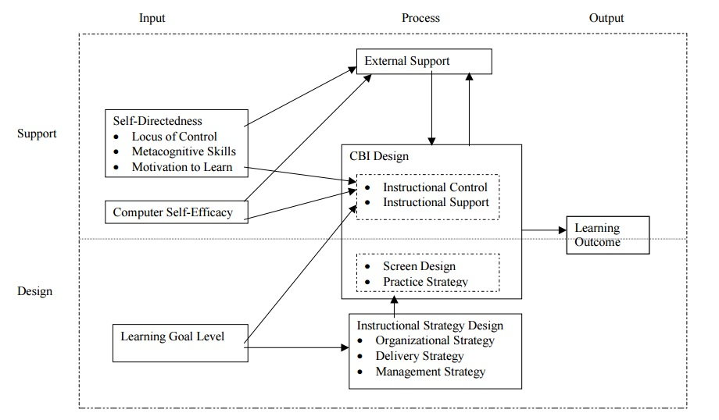

Slide 8
Process Units of Theory

Slide 9
What is an input?
Input is something put into a system or expended in its operation to achieve output or a result.

Slide 10
What is Self-Directed Learning?
Self-directed learning, which has its roots in adult education, is an approach that has also been tried with learners in elementary and secondary schools. There may be slight variations in how different educators define SDL, but a survey of the literature on the subject identifies several tenets that are central to the concept.

Slide 12
DEFINITION
“Self Directed Learning is any knowledge, skill, accomplishment, or personal development that an individual selects and brings about by his or her own efforts using any method in any circumstances at any time”. GIBBONS (2002).

Slide 13
DEFINITION
“ A process in which individual take initiative, with or without the help of other, to diagnose their learning need, formulate learning goals, identify resources for learning, select and implement learning strategies and evaluate learning outcomes”. KNOWLES (1975).

Slide 14
PRINCIPLES - SDL
SDL should be congruent with life long, natural and individual learning drives.
Should be adapted to the maturation, transformations and transitions experienced by the learners.

Slide 15
SDL should be concerned with all aspects of a full life.
It should employ a full range of human capabilities, including senses, emotions and actions as well as intellects.
SDL activities should be conducted in settings suited to their development.

Slide 16
PROCESS OF SDL

Slide 17
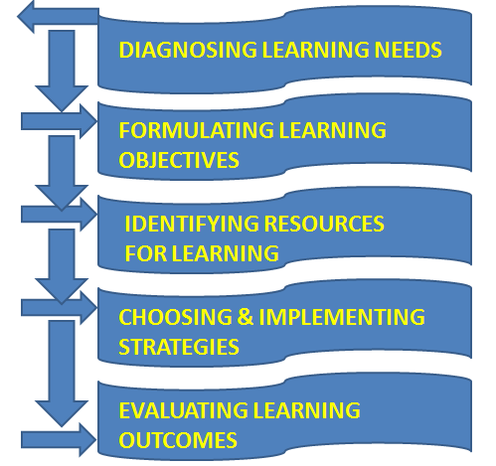
THE PROCESS (KNOWELS)

Slide 18
SELF DIRECTED LEARNER

Slide 19
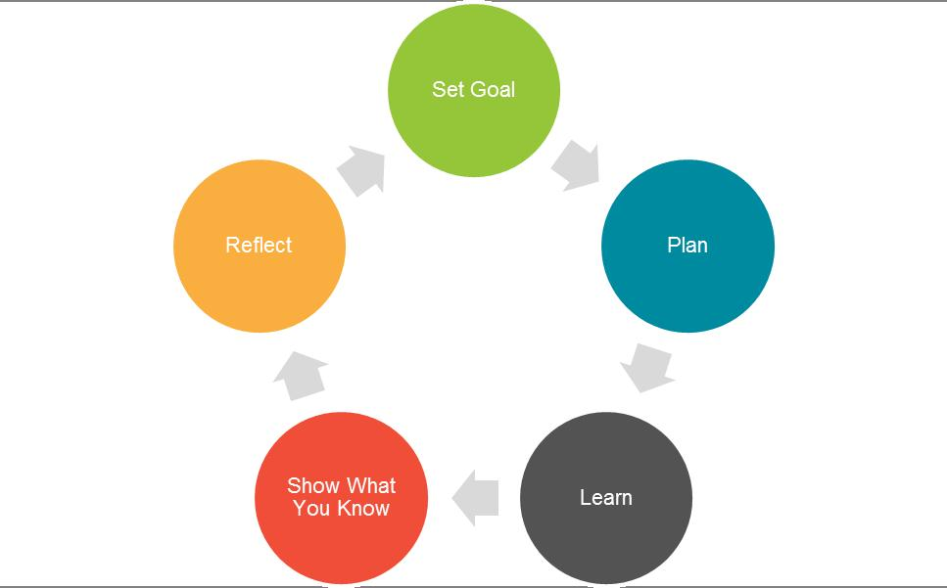
LEARNING STEPS BY SELF DIRECTED LEARNER

Slide 20
PROCESS INSIDE THE SELF DIRECTED LEARNER

Slide 21
SKILLS REQUIRED FOR SDL

Slide 22
ROLE OF A TEACHER IN SDL
Teach inquiry skills, decision making, personal developments & self evaluation of work.
Help learners to develop positive attitudes and feeling of independence related to learning.

Slide 23
Help learners to acquire the needs and assessment techniques necessary to discover what objectives they should set.
Help the learners identify the starting point for a learning project and understand the relevant modes of examination and reporting.

Slide 24
Create a partnership with the learner by negotiating a learning contact for goals, strategies and evaluation criteria.
Ensure that the learners are aware of the learning objectives, learning strategies, resources and evaluation criteria.

Slide 25
Teach inquiry skills, decision making, personal development and self evaluation of work.
Act as an advocate for educationally underserved populations to facilitate their access to resources.

Slide 26
Help match resources to the needs of the learners.
Encourage critical thinking skills.
Create an atmosphere of openness and trust to promote better performance.

Slide 27
HOW TO INTEGRATE SDL WITH REGULAR TEACHING LEARNING

Slide 28
COMPARISION WITH TRADITIONAL METHOD

Slide 29
ADVANTAGES
SDL allows the learners to be more effective learners.
SDL helps the learners to develop a sense of responsibility.

Slide 30
SDL encourages the learners to develop their own rules and leadership patterns.
SDL helps the learners to be motivated and persistent, independent, self disciplined, self confident and goal oriented.

Slide 31
DISADVANTAGES
Research has proved that some adults are unable to engage in self directed learning because they lack independence, confidence or resources.

Slide 32
Learners can be easily distracted by their own needs, assumptions, values and misperceptions.

Slide 33
Self Directed Learning needs to be combined with other learning methods for content to be fully learned.

Slide 34
Video: https://www.youtube.com/watch?v=-6TbDQMB-NU

Slide 35
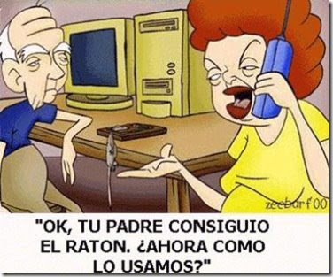
Computer Self efficacy

Slide 36
Video: https://www.youtube.com/watch?v=fjIxawmK7uw

Slide 37
Technological Self efficacy
(TSE) is “the belief in one’s ability to successfully perform a technologically sophisticated new task This is a specific application of the broader and more general construct of self-efficacy, which is defined as the belief in one’s ability to engage in specific actions that result in desired outcomes. Self efficacy does not focus on the skills one has, but rather the judgments of what one can do with his or her skills. Traditionally, a distinguishing feature of self efficacy is its domain-specificity. In other words, judgments are limited to certain types of performances as compared to an overall evaluation of his or her potential.

Slide 38
Importance
Today’s modern society is completely embedded within a technological context, which makes the understanding and evaluation of technological self efficacy critical. Indeed, nearly half of Americans own smartphones and this trend towards technology use is not limited to the United States; instead cell phone, computer, and internet use is becoming increasingly common around the world.

Slide 39
Video: https://www.youtube.com/watch?v=UFwWWsz_X9s

Slide 40
Level Learning Goals
Program- or department-level learning goals can bring coherence to a curriculum and help both students and faculty see how courses in a program interact with and build on each other. A clearly articulated, relevant set of program-level Learning goals can guide the assessment of learning by providing feedback on the extent to which the program is reaching its publicly stated goals. In this process it’s valuable to know how, where, and when majors and prospective majors gain an overview of the goals of the undergraduate program and develop an understanding of what they will know or be able to do at the end of their course of study.

Slide 41
Developing a set of program level outcomes begins with the identification of values, goals, or the mission of an academic program, how these elements relate to students moving through the program, and what essential things they need to learn in the process. Program-level learning goals set the higher level learning goals for all students in the program. At this level, learning goals are broad in scope and tend to focus on a well-rounded student learning experience but should still be realistic and meaningful to faculty and students.

Slide 42
VIDEO https://www.youtube.com/watch?v=CaOVR_1m5qM

Slide 43
Laws of Interaction

Slide 44
What is a Law of Interaction?
law of interaction is a statement by the researcher-theorist of the relationship between units and shows how the units of the theory are linked. In this section, the laws of interaction of “A Theory of Effective Computer-Based Instruction for Adults” are developed.

Slide 45
To provide for the output of learning outcome, the CBI design unit interacts with the other units of the model: self-directedness, computer self-efficacy, external support, instructional strategy design, and learning goal level.
The units of the model were arranged into two distinct horizontal halves of the model, the top half of support and the bottom half of design. The units of the support half are external support, self-directedness, computer self-efficacy and the components of instructional control and instructional support of CBI design. The units of the design half are learning goal level, instructional strategy design, and the components of screen design and practice strategy of CBI design. The learning goal level influences both the support and design halves of the model.

Slide 46
Self-Directedness and CBI Design
Self-directedness is expected to influence the components of instructional control and instructional support of the unit domain of CBI design. Learners who possess internal locus of control, high metacognitive skills, and a high level of motivation to learn will be successful using learner controlled options for CBI design and less instructional support. Learners who possess external locus of control, low metacognitive skills, and low level of motivation to learn will need program control for instruction and much instructional support.

Slide 47
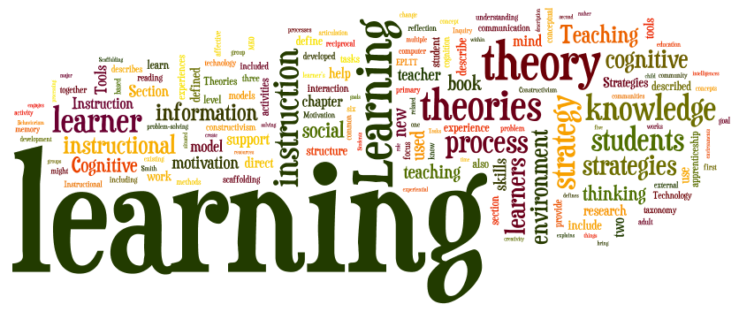
Another reason for using learner control is that it helps students become independent learners and develop their self-efficacy and self-determination (Kinzie, 1990; Snow, 1980). Mager (1964) and Merrill (1975) contended that learners know their own instructional needs best and are uniquely qualified to tailor instruction to meet those needs.

Slide 48
The four stages of self-directedness
Stage 1
The dependent learner with the teaching style of authority and coach.
Stage 2
The interested learner with the teaching teaching style of motivador and guide.
Stage3
The involved learner with the teaching style of facilitator
Stage 4
The self-directed learner with the teaching style of consultant or delegator.

Slide 49
Computer Self-Efficacy and CBI Design
Computer self-efficacy is expected to influence the components of instructional control and instructional support of the unit domain of CBI design. Learners with low computer self-efficacy must be given the opportunity to be successful. Only through experience and success with CBI will the computer self-efficacy level rise. Instructional support such as feedback and coaching needs to be available to the learner to enable them to be successful.

Slide 50
Self-Directedness and External Support
Self-directedness is expected to influence the unit of external support. The higher the level of self-directedness of the learner, the less external support is required. For instance, the learners who possess internal locus of control, high metacognitive skills, and high motivation to learn require less external support.

Slide 51
Prepositions

